Slide 1



SCOTIA UPI
PREPARED BY
ABIMBOLA SANNI
BHUPINDER SINGH
GEETHU JOY
MAHEEP KAUR
YASH SURTI

Slide 2

EXECUTIVE SUMMARY
SWOT ANALYSIS
PESTEL
HOW IT WORKS
BENEFITS
WHY UPI

Slide 3
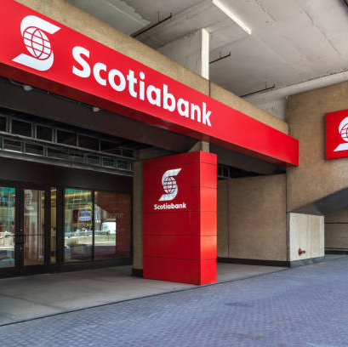
EXECUTIVE SUMMARY
Founded: 1832, Halifax, Nova Scotia
Assets and Financial standing: Asset worth over CAD 1 trillion, 3rd Largest bank in Canada. Earned about $ 2.16 billion ($1.69 per share)for Q2 2023
Global Presence: Significant operations in the Caribbean, Central and South America, and parts of Asia.
Services: Diverse financial offerings, including retail, commercial, and investment banking, plus wealth management.
Digital Innovations: Advanced mobile apps, online platforms, and fintech integration.
Strategic Moves: Acquisitions and divestitures in growth markets.
CSR: Strong commitments in education, health, and sports.
Regulation: Supervised by OSFI in Canada and complies with international standards.

Slide 4
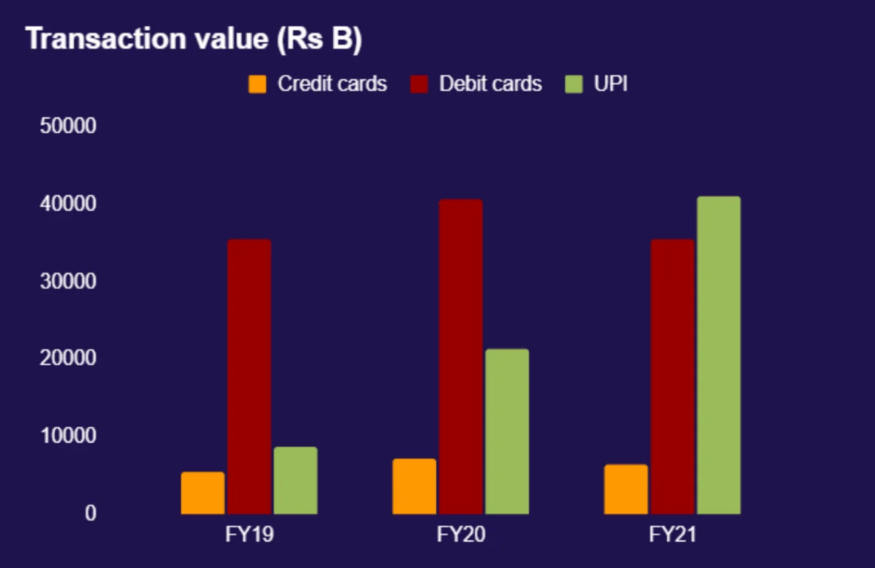
Executive Summary
The purpose of delineating the advantages of Scotiabank's adoption of UPI (Unified Payments Interface) is to:
Scotiabank can maintain its leading position in the rapidly expanding financial technology market.
Scotiabank hopes to increase operational productivity, cut expenses, and speed up payment transfers.
Key Advantages:
Market penetration
Cost-Efficiency
Consumer satisfaction and loyalty.
UPI | Interac
Transaction Volume: December 2022, UPI processed over 4.2 billion transactions in a single month. | Transaction Volume: In 2022, Canadians sent more than 763 million Interac e-Transfer transactions.
Transaction Value: The value of these transactions was over INR 7.3 trillion (approximately USD 98 billion) in December 2022. | Transaction Value: The total value of these e-Transfer transactions in 2022 was over CAD 286 billion.

Slide 5
SWOT
STRENGTH WEAKNESS
SCOTIA
Global presence: US & Canada
Scotia TranXact
Diverse Revenue Streams
BMO
US & Canada
Innov8
Wealth management and financial planning
BMO​
Profitability
Market cap
Limited Local markets
SCOTIA​
19.68% YoY decline
Market cap
Limited domestic focus
Behind TD and BMO
Mexico, Peru, Chile and Colombia
Retail banking & international operations
TD
US & Canada
TD Global transfer and UGO
Insurance.
CIBC
US & Canada
C Suite
Personal & business banking
TD​
Technology Investment
Customer Service Issues
Dependence on US and Canada : Fewer branches
CIBC​
Gap in Technology Investment
Market Share
Cybersecurity Risks

Slide 6
SWOT
OPPORTUNITIES THREATS
BMO
Developing regions
User-friendly interfaces, & novel digital offerings.
innovation & digital banking
BMO​
Competition
Regulatory risk
Economic fluctuations
Customer habits
SCOTIA
Expansion : Latin America
Technology investments
Fintech Partnership
SCOTIA​
Competition
Regulatory risk
Economic fluctuations
Political risks
Cutting-edge technology and user-friendly interfaces.
Block chain
TD
US & other countries
AI, machine learning, data analytics and mobile technology
cost saving and efficiency
TD​
Competition
Government Regulations
Currency Swings
Mortgage and Loan Regulations
CIBC​
Competition
Past Issues
Uncertain Environment
Increased Marketing Efforts
CIBC
North American countries
AI, machine learning, data, and analytics
Cloud Technology

Slide 7
Market Expansion
Revenue Generation
Operational Efficiency
Data Analytics
Risk Management
Customer Protection
E
T
L
P
S
E
Regulatory Support
International diplomacy
Customer Satisfaction
Social Integration
Resource Optimization
Corporate sustainability

Slide 8
Summary of Scotia UPI(Unified Payments Interface)
Employs UPI technology to transform digital payments in Canadian market.
Mobile-first strategy provides clients with the ease of seamless, cost-effective real-time transactions.
Strong authentication mechanisms (Detecting mobile location, OTP, Device PIN and transaction PIN).
Decreasing reliance on old means such as Interac eTransfer.
Notes:
Scotia UPI, Scotia Bank's unique payment solution launched in the Canadian market, employs Unified Payments Interface (UPI) technology to transform digital payments. Scotia UPI, which takes a mobile-first strategy, provides clients with the ease of seamless, cost-effective transactions, allowing them to send money, pay bills, and make purchases straight from their bank accounts. This forward-thinking device not only improves security through solid authentication mechanisms (Detecting mobile location, OTP, Device PIN and transaction PIN), but it also has a global reach, allowing international transactions where UPI is accepted. Scotia UPI represents a strategy change, to diversify payment choices, decreasing reliance on old means such as Interac eTransfer, and positioning Scotia Bank at the forefront of technological innovation in the financial industry, eventually improving the consumer banking experience.

Slide 9

How does it feel to have all your bank apps and bill payments in one app? Do you know you can make payments at retail stores by just scanning a barcode?

Slide 10
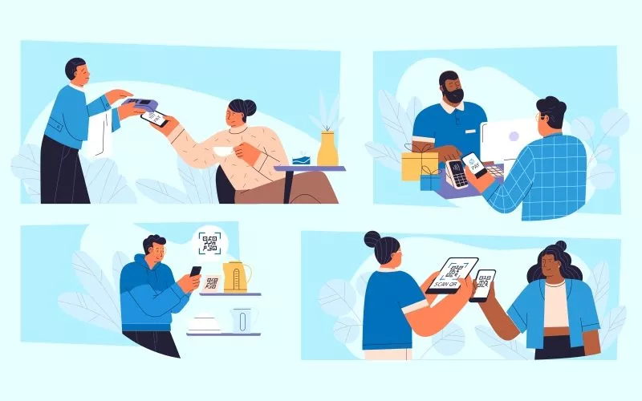
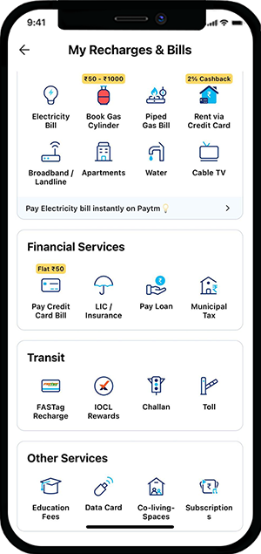
HOW IT WORKS
Bill Payments
Over-the-counter (OTC) payments
by scanning QR codes
Das, Y. (2022a, August 17). How to send money using Paytm?https://paytm.com/blog/paytm-help/how-to-send-money-using-paytm/
Das, Y. (2022, August 18). How to pay utility bills on Paytm?.https://paytm.com/blog/paytm-help/how-to-pay-utility-bills/

Slide 11
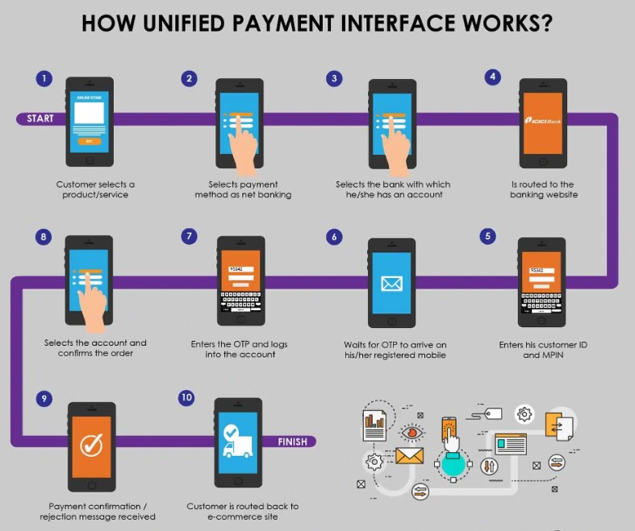
HOW IT WORKS
Interbank Transfer

Slide 12
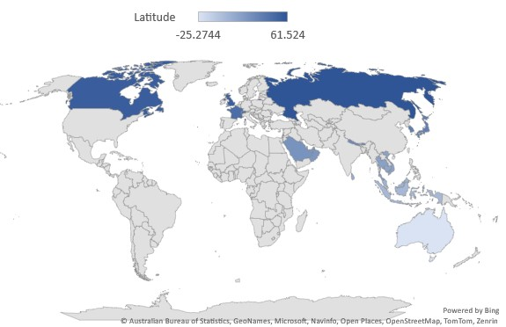
Expected Benefits from Scotia UPI
Global Acceptance
Cost-Efficient
Better Real-time banking experience
Opportunity to future-ready business model
Forefront of technological innovation in the financial industry.
Service, G. D. (2015, July 24). Countries in the EU and EEA. GOV.UK. https://www.gov.uk/eu-eea
Notes:
Global Acceptance: Acknowledging UPI growth, many countries like South East countries, Russia, European Union, Canada, Australia and still adding.
Cost-Efficient: Here, customers enjoy this service at 0 fee payment where as retail merchants pay 1% charge for the transaction.
Better Real-time banking experience: Transaction can send and receive in snap of fingers.
Opportunity to future-ready business model: UPI system will be offered to other financial institutes at lower fee than interac with great reward offers
Forefront of technological innovation in the financial industry.

Slide 13
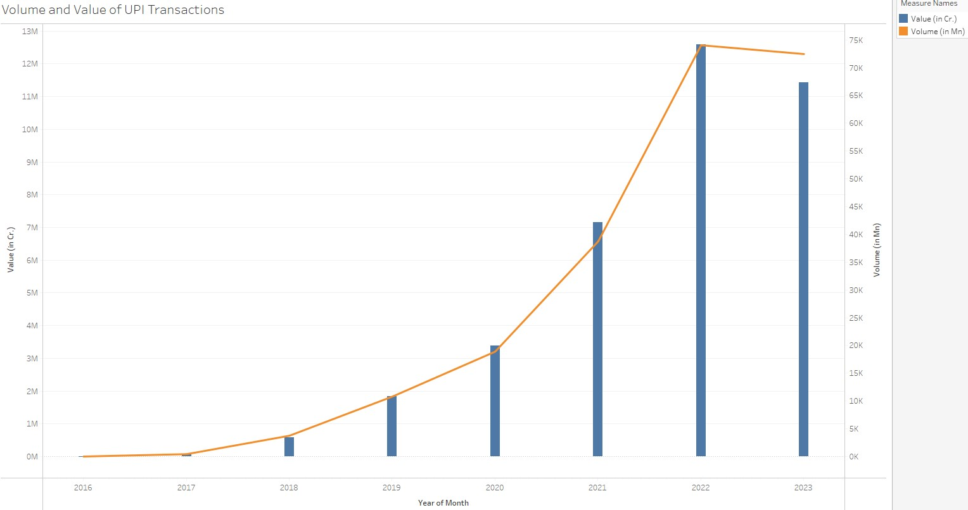
Expected Benefits from Scotia UPI (cntd.)
Rise of UPI
Interac usage by Canadians has climb by 49% by 2023.
In 2023, the number and value of UPI transactions ever recorded because of a surge in transaction volume of 82% and value growth of 65%.
Unified payments interface (UPI) product statistics: NPCI. National Payments Corporation of India (NPCI). (n.d.). https://www.npci.org.in/what-we-do/upi/product-statistics

Slide 14
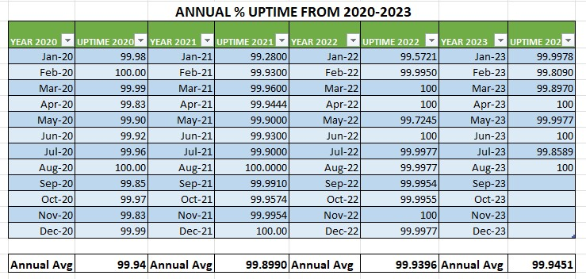
Benefits to customers
Ease of Use
Enhanced Security
Payment Versatility
Simplified Record-Keeping
Accessibility
Reliable(99.94% uptime)

Slide 15
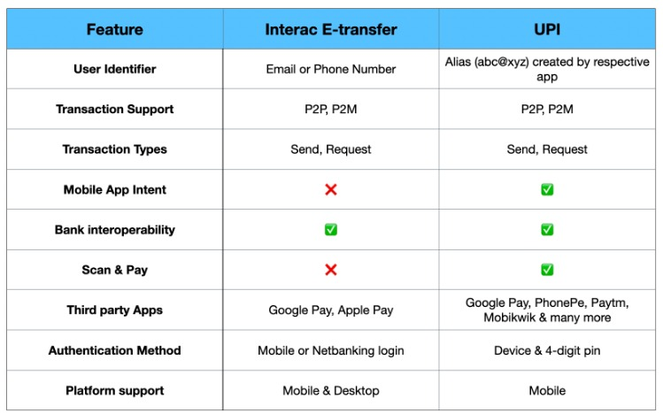
Why Scotia UPI?
No mobile banking login is required.
The current Canadian banking system lacks real-time transaction features.
Opportunity to grab the digital payment market.
Provide usage of UPI API for third-party usage.
Pruthi, S. (2022, September 22). UPI(India) vs Interac E-transfer(Canada). LinkedIn. https://www.linkedin.com/pulse/upiindia-vs-interac-e-transfercanada-saajan-pruthi/

Slide 16


Slide 17
Reference
Das, Y. (2022, August 18). How to pay utility bills on Paytm?. A Comprehensive Guide to Money Transfer, Recharges, Bill Payments and Other Digital Payments | Paytm Blog. https://paytm.com/blog/paytm-help/how-to-pay-utility-bills/
Das, Y. (2022a, August 17). How to send money using Paytm?. A Comprehensive Guide to Money Transfer, Recharges, Bill Payments and Other Digital Payments | Paytm Blog. https://paytm.com/blog/paytm-help/how-to-send-money-using-paytm/
Mundhra, L. (2023, January 4). UPI transaction value grows 7% mom to $155 bn in December 2022. Inc42 Media. https://inc42.com/buzz/upi-transaction-value-grows-7-mom-to-155-bn-in-december-2022/
Pruthi, S. (2022, September 22). UPI(India) vs Interac E-transfer(Canada). LinkedIn. https://www.linkedin.com/pulse/upiindia-vs-interac-e-transfercanada-saajan-pruthi/
Service, G. D. (2015, July 24). Countries in the EU and EEA. GOV.UK. https://www.gov.uk/eu-eea
Unified payments interface (UPI) product statistics: NPCI. National Payments Corporation of India (NPCI). (n.d.). https://www.npci.org.in/what-we-do/upi/product-statistics

